Slide 1
Lectures Universidad del Desarrollo
Francesco Bogliacino
July 2025

Slide 2
Lecture 1

Slide 3
Why this course
This is not just another course on a platform for experiments
This is a set of good practices + an introduction to JS
It is based on one key principle:
As experimentalist, we rely on the design, so we need to try to solve as many problems as possible while designing the experiment

Slide 4
Let’s start
Things to do: start a project, key information
Documentation is very important so make sure that you add title, description, and that you created a GitHub or OSF file (you may also create the Github folder and link to an OSF project via adds-on Github, choosing one folder)
Learning about some basic tabs:
Folder to upload static files
html
CSS (we will see later)

Slide 5
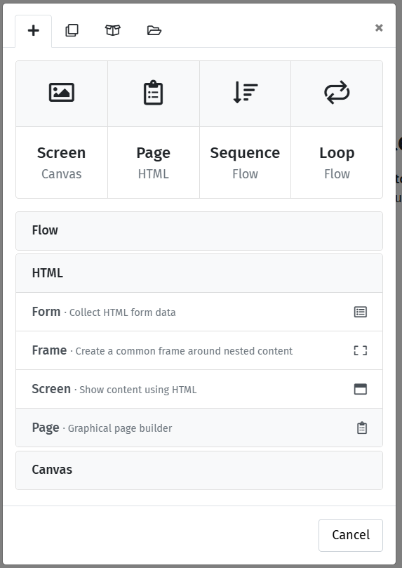
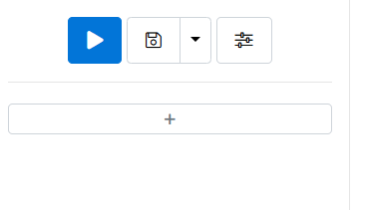
Start by a basic form
You will be asking questions. The way a web interface collects response is through a form
To introduce a form,

Slide 6
The first form
We will ask two simple questions: gender and age.
But this will be our way to learn a bit about html and css
First give a name to the form

Slide 7
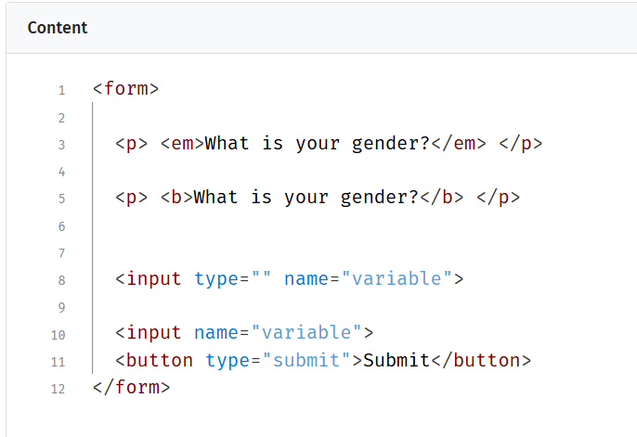
The html
Html is a markup language. You do not perform tasks and operation. It is focused on presentation;
The key concept is tag. A tag is opened and closed as <tag></tag>.
Italic and bold are controlled as tags

Slide 8
The input tag
The key tag to collect data for us will be the input tag;
The input element does not require a closing tag because it is used to create various types of form controls, such as text fields, checkboxes, radio buttons, and buttons;
There is plenty of types, so let’s learn about a few of them that are useful

Slide 9
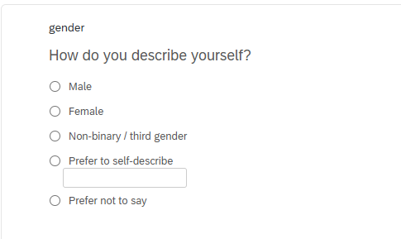
The gender question
We follow the Qualtrics validated question. We need five radio buttons and one text

Slide 10
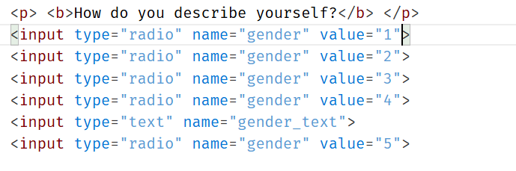
The gender question
We follow the Qualtrics validated question. We need five radio buttons and one text
Three problems
Required response
Formatting
Labels

Slide 11
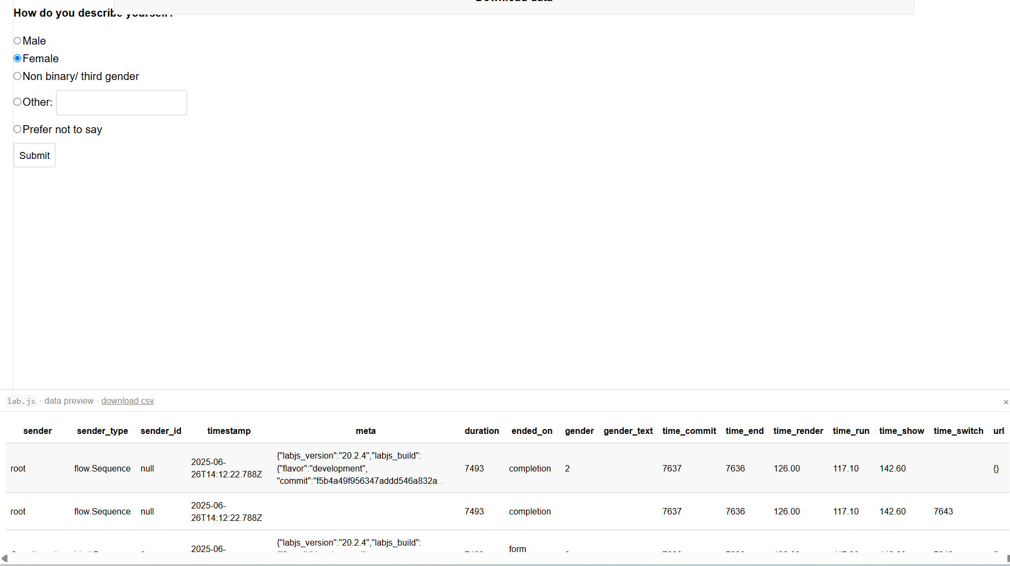
Let’s try to answer and look at the data

Slide 12
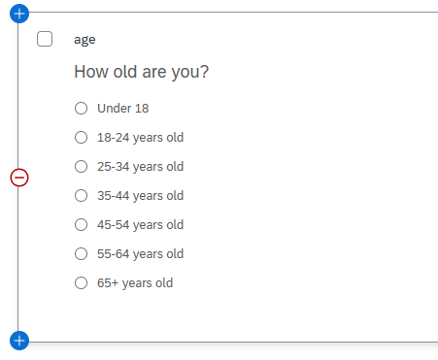
The age question
Try to implement the same question

Slide 13
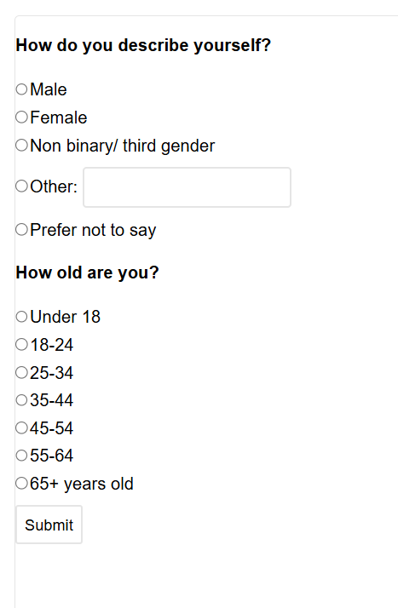



The interface is terrible

Slide 14
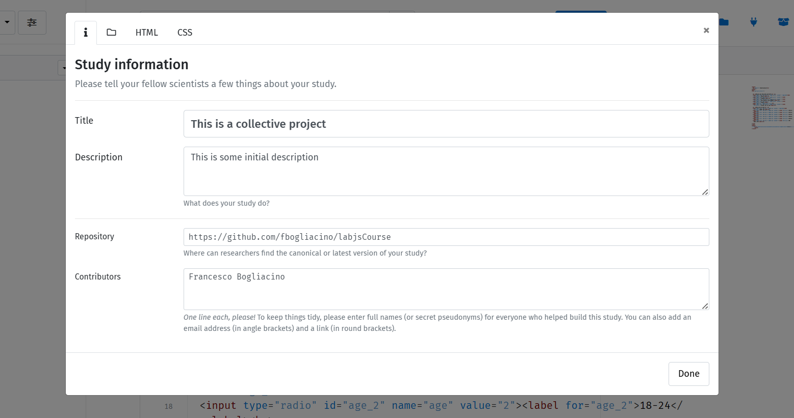
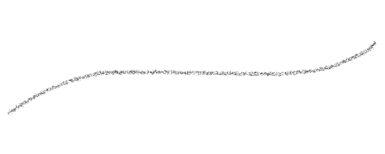
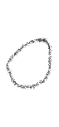

How to work in style
Notice that there is a baseline html

Slide 15

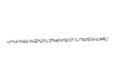



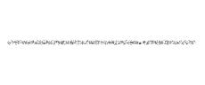


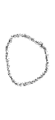





How to work in style
The key is the use of CSS. CSS is a programming language
You can typically define tags and classes in CSS
Play with some simple properties
main{
margin-left: 510px;
margin-right: 200px;
background-color: whitesmoke;
text-align: justify;
}

Slide 16
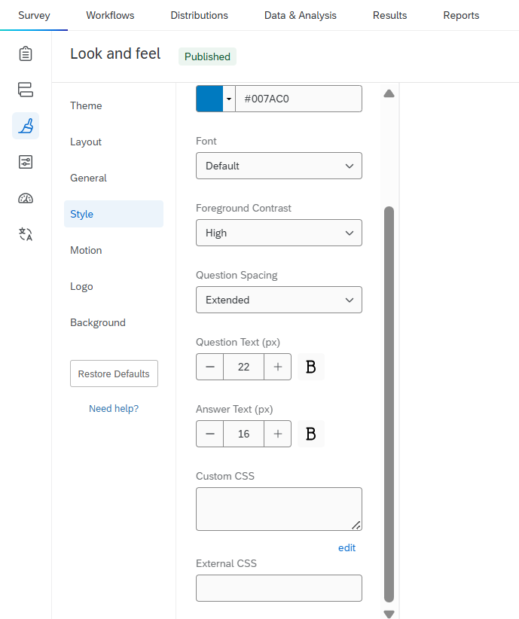
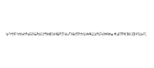
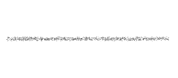

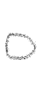
Notice: Qualtrics
You can use CSS to customize in most of experimental softwares, from Qualtrics to JATOS, from oTree to …

Slide 17
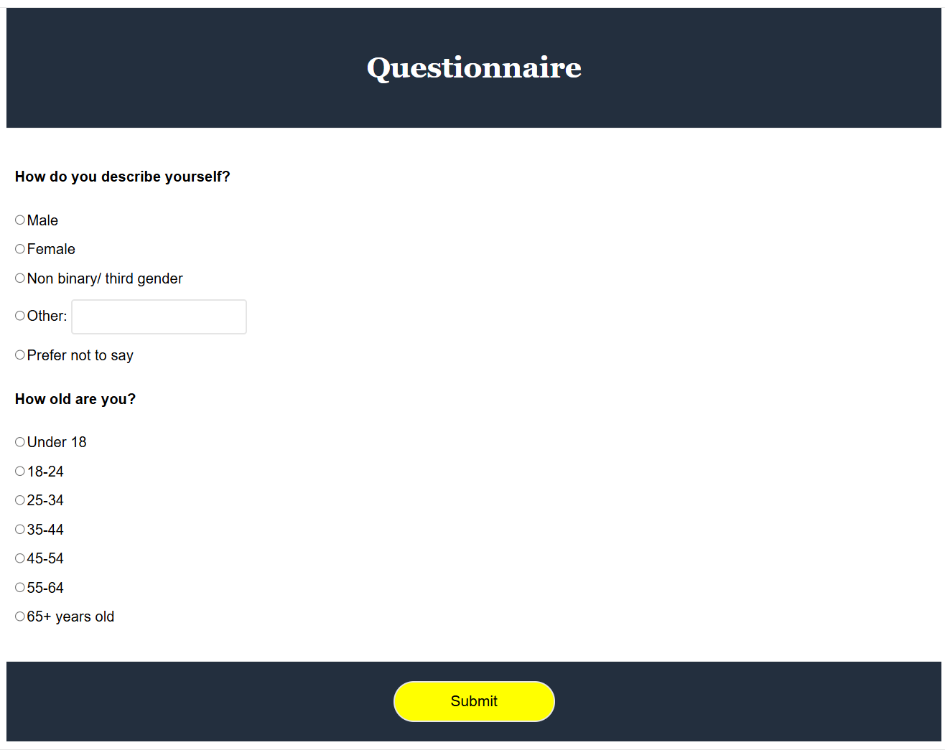

Slide 18
Lecture 2

Slide 19
Before jumping to the main task
There is a typical step you will need before starting: the informed consent
The basic ingredients of an informed consent are text and checkbox
Try a few minutes to work it out

Slide 20
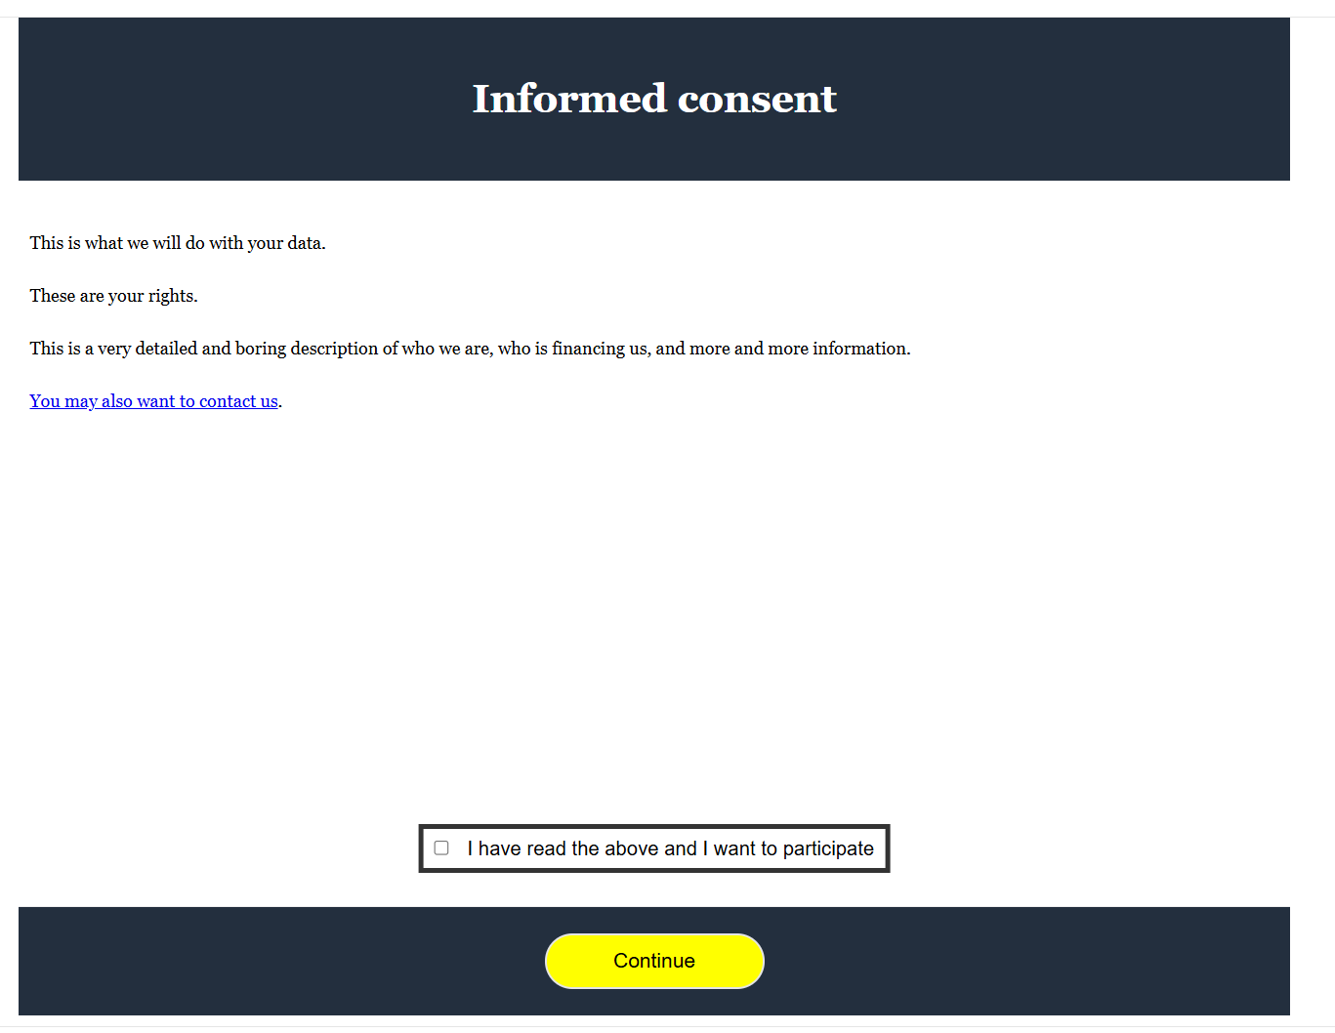
Informed consent
Remember the email contact
Check the css code

Slide 21
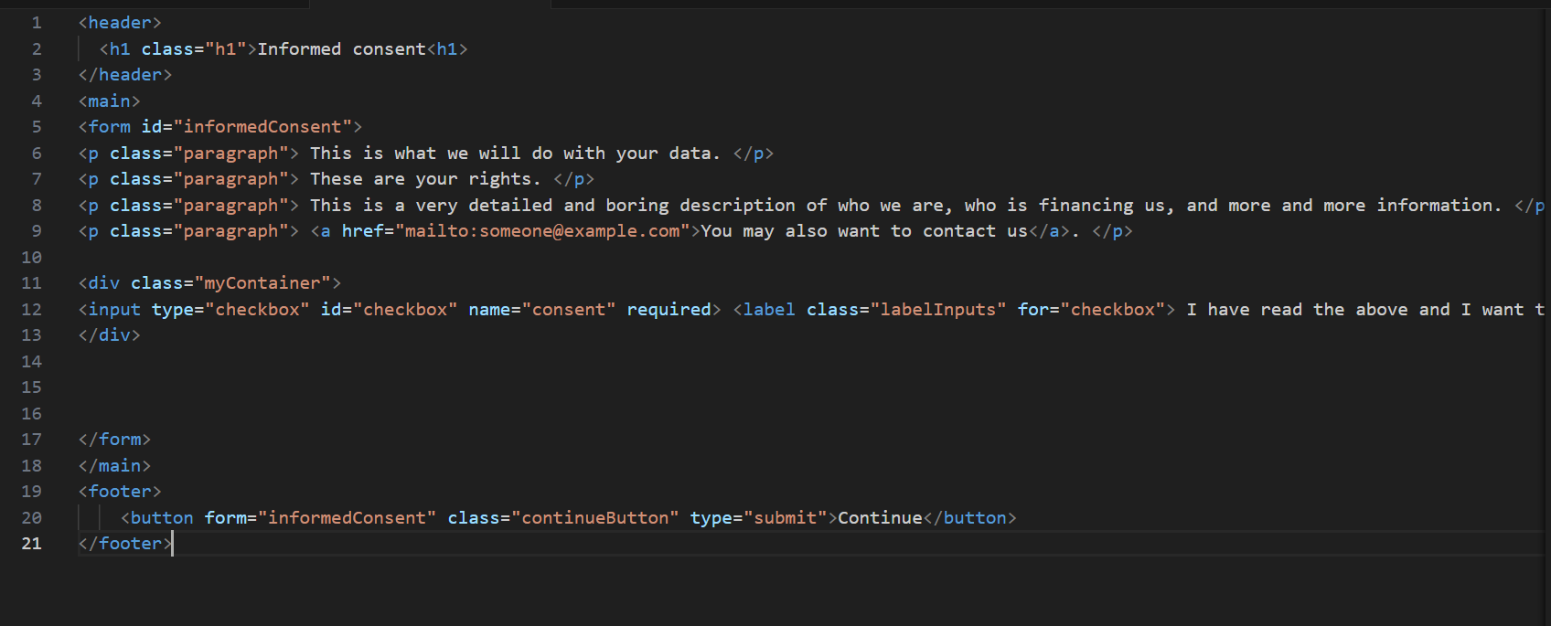
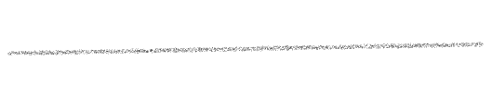
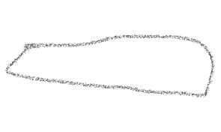
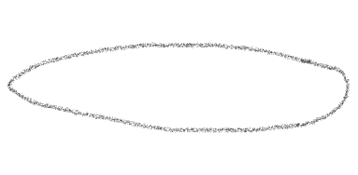

Slide 22
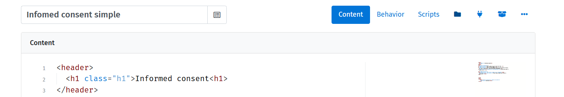
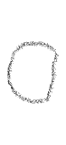
Informed consent
This format is not flexible enough (what if the IRB asked us to use a two pages IC?) and already contained too much text;
We can use the iframe tag, which allows embedding a document within the document

Slide 23
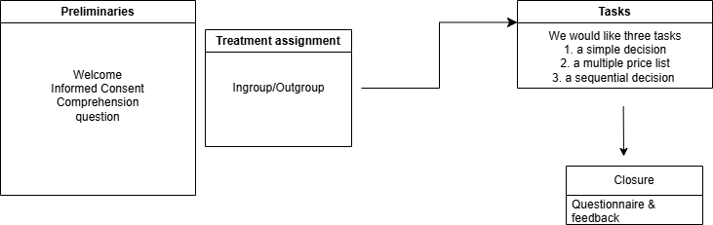
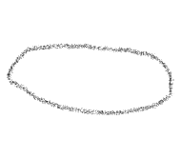
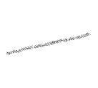









Now let’s pause for a moment
What do we want to do?
randomization
Single switch
matching
Feedback & controlling attempts

Slide 24
Lecture 3

Slide 25
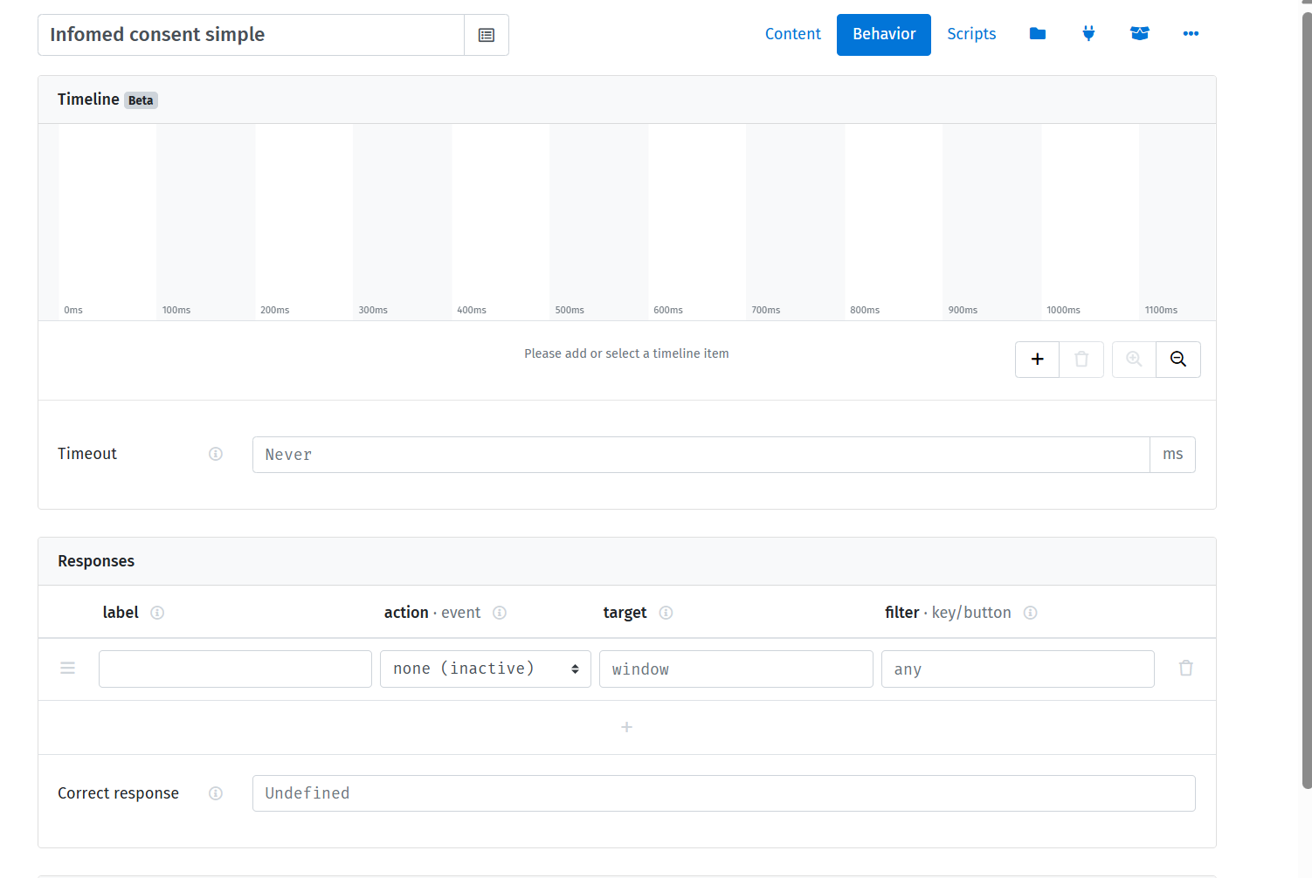
The DOM (Document Object Model) & JS
You can notice that there is a «behavior» tab that allows you to experiment with timeout, manipulate responses from the keyboard etc
But for us the most important thing is the «script» tab, which introduces us to JS language
JS language is the most important language for FrontEnd. Even though Pyton is obviously the «cool» language now, you can take advantage of JS for oTree (Lioness is JS+SQL)

Slide 26

JS
We are not going to learn JS, but I really would like to motivate you to continue working with it
The minimal concepts we are going to need:
Values (data, the units of information) in JS comes in two forms primitives & object
Let’s have a look at our code and understand some important concept

Slide 27
JS
We are not going to learn JS, but I really would like to motivate you to continue working with it
The minimal concepts we are going to need:
Values (data, the units of information) in JS comes in two forms primitives & object
Every js file is a different program. For you every «script» is a different program, so you should take that into account when you move across pages

Slide 28
JS
We are not going to learn JS, but I really would like to motivate you to continue working with it
The minimal concepts we are going to need:
Values (data, the units of information) in JS comes in two forms primitives & object
Every js file is a different program. For you every «script» is a different program, so you should take that into account when you move across pages
We can have functions (collections of procedures with input and output)

Slide 29
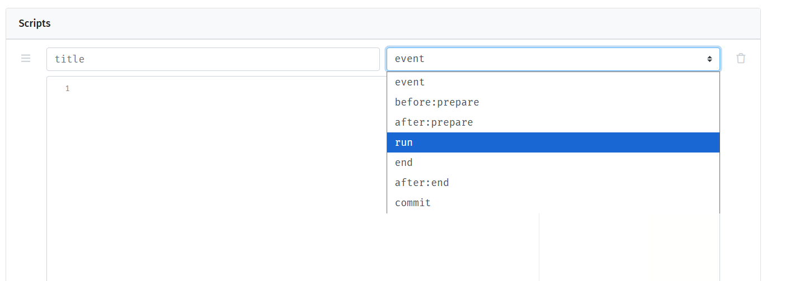
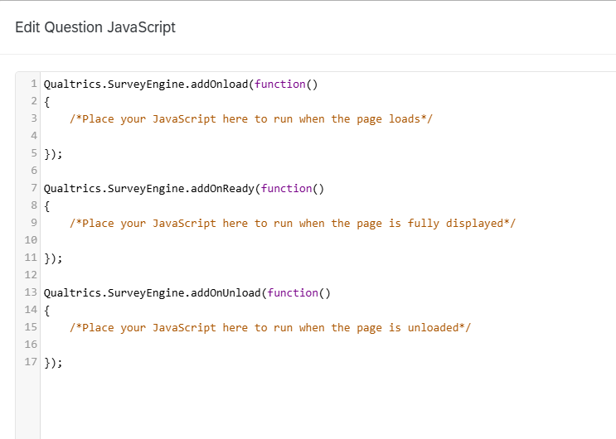
JS
Notice that you have to declare when the procedures you are writing should be executed (most of the time it’s going to be «run»)
This means that they are included into functions
Notice that there is a parallel in Qualtrics

Slide 30
How do we write the typical objects?
One thing is an array
In arrays, components are ordered and have an index
Arrays’ index starts from 0 always
You may have arrays of numbers, strings, arrays, objects, …
Objects are unordered keyed collections of any values
How you recover the value?
Not by index, by the key (or property)

Slide 31
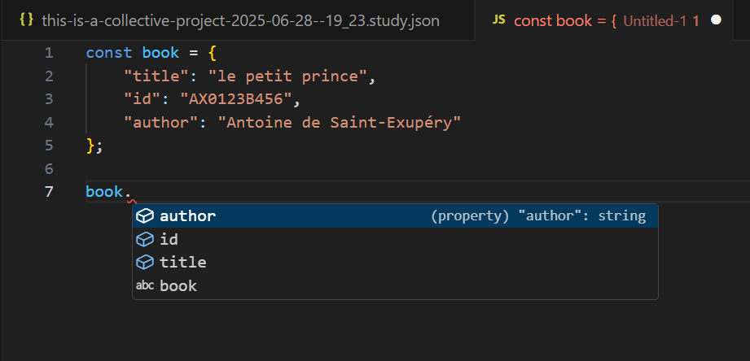
How do we write the typical objects
We can define objects and recall their properties

Slide 32
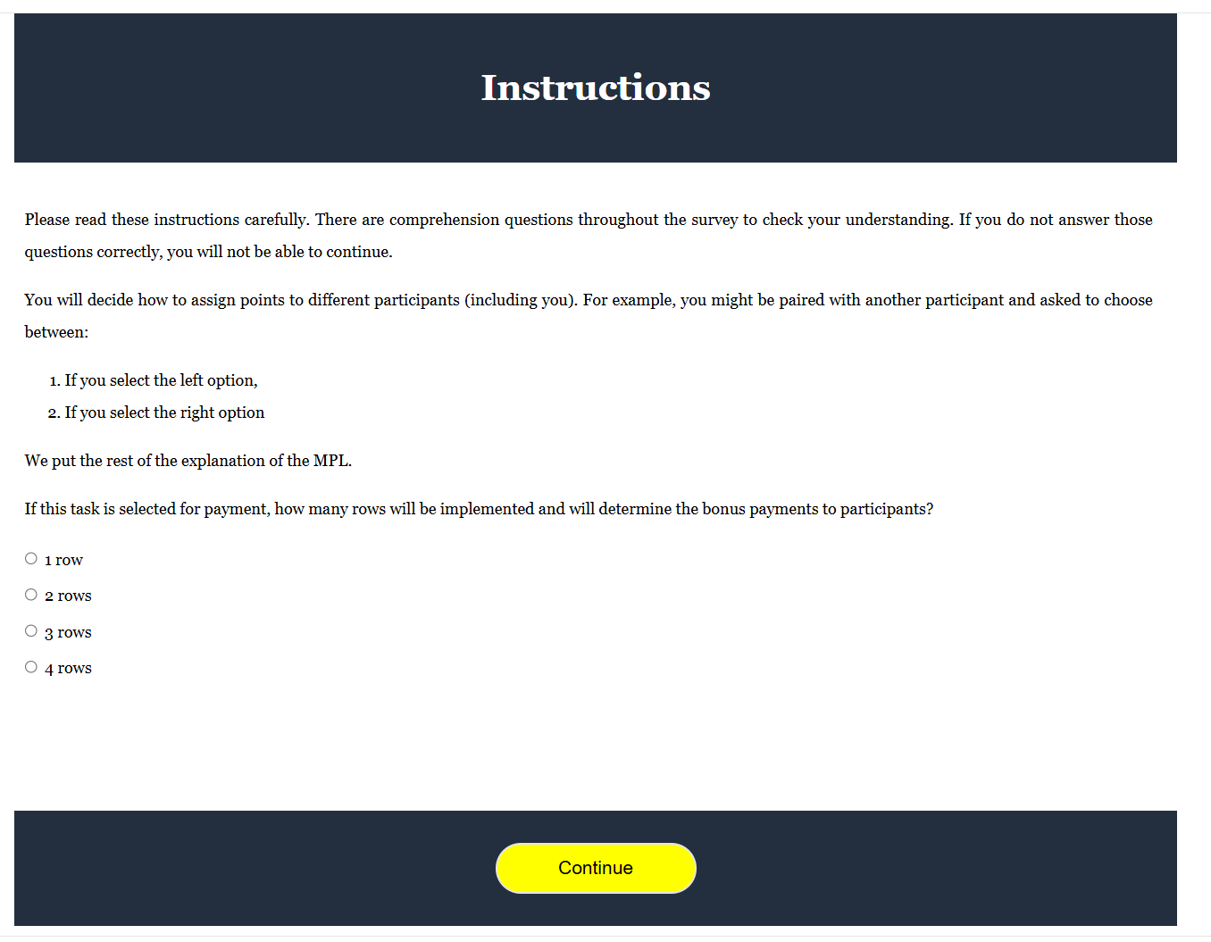


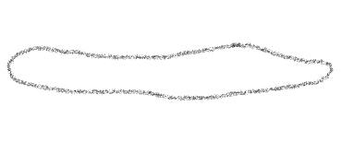
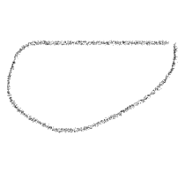


What we would like
We need some «manipulation» of the main document
This is the concept of DOM

Slide 33
Reasoning in terms of objects
We can think at «things» on the main document as objects that we want to dynamically modify
If a paragraph is an object, we would need to call it and we would like to change its content
We would need a trigger: when the participant does something (provide an answer) we alter the paragraph to provide the response

Slide 34
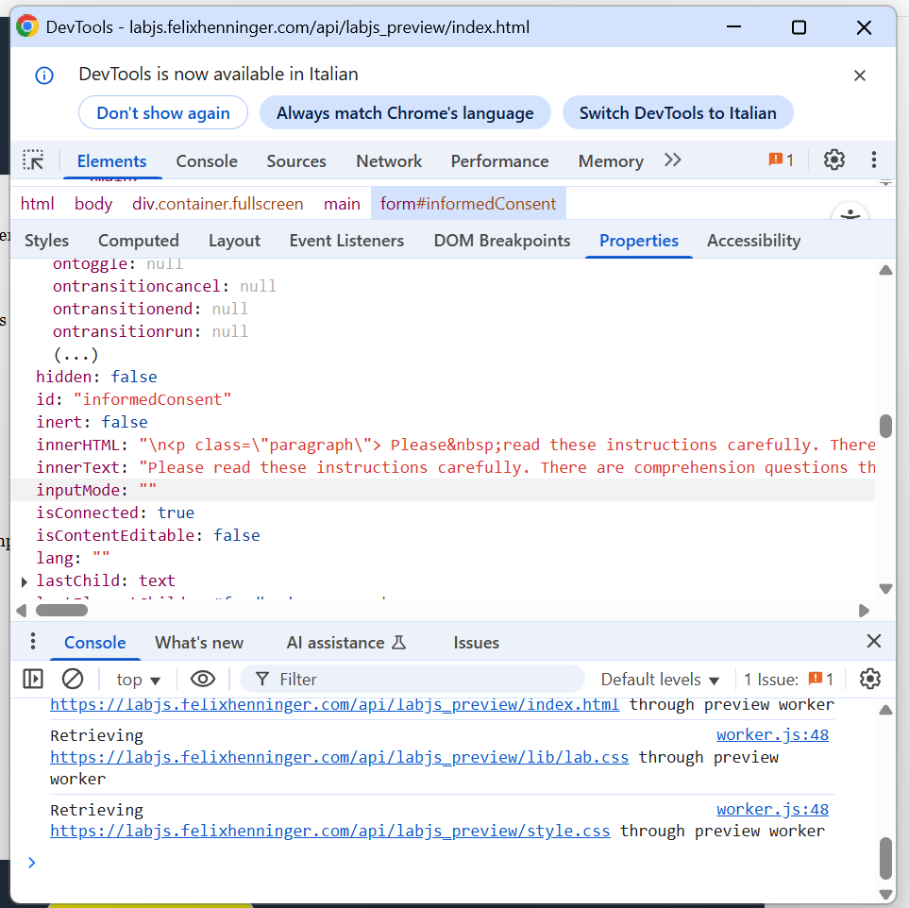
Learning and debugging
One way to learn about the structure of the DOM is through the dev tools of your browser
Notice that there is a console. The console is perfect for debugging

Slide 35
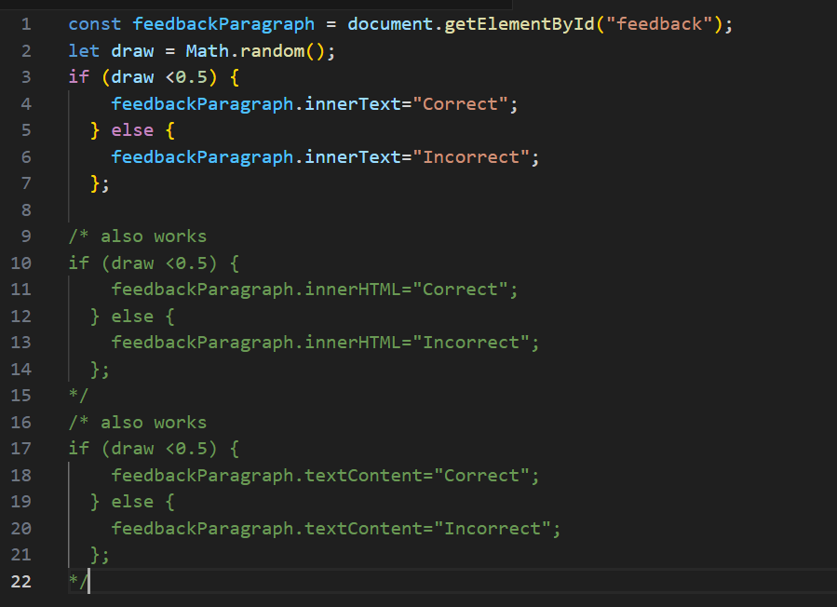
Manipulation of the DOM
We have variable declaration (const/let/var);
We have the use of some methods (Math.random())
We are manipulating some properties

Slide 36
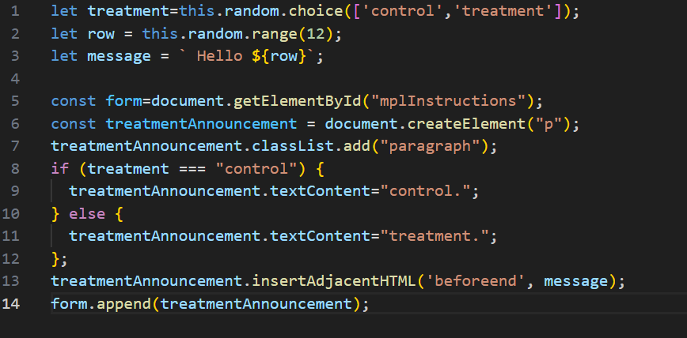
Manipulation of the DOM
Careful on comparisons. In JS these can be nightmares
===
==
But careful also with < and >

Slide 37
Lecture 4

Slide 38
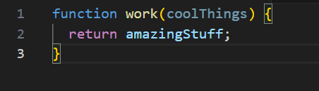
The trigger
The addEventListener() method of the Event’s Target interface sets up a function that will be called whenever the specified event is delivered to the target;
We need to generate a function (a set of instructions);
The normal way to generate functions is through a function declaration

Slide 39
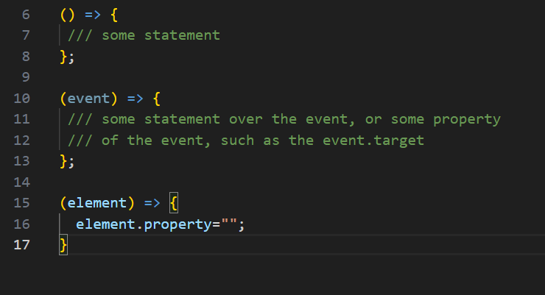
The trigger
However, most of times, you can work with simple function declarations, called arrow functions

Slide 40
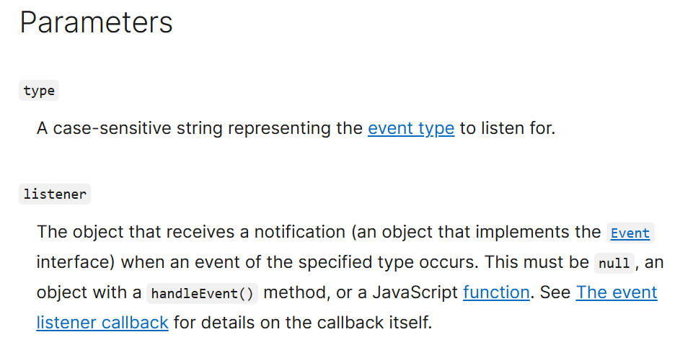
addEventListener
We need to specify the event and the function that we want to implement

Slide 41
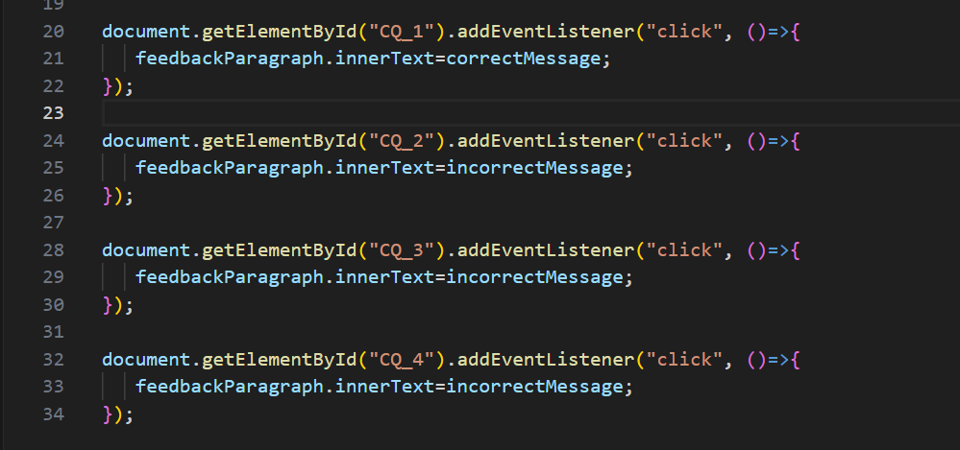
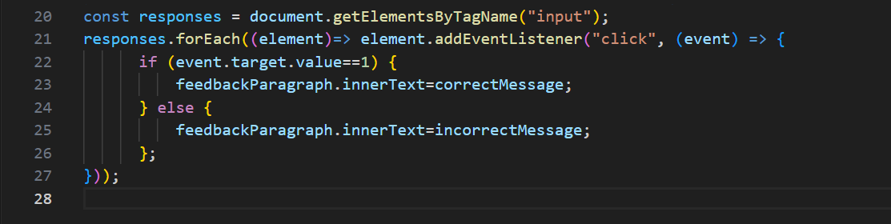
Re-factorize the code

Slide 42
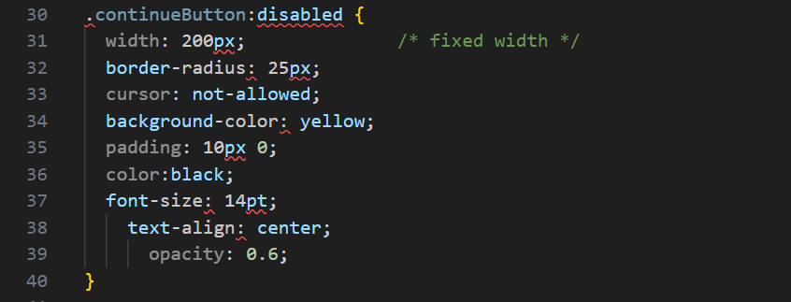
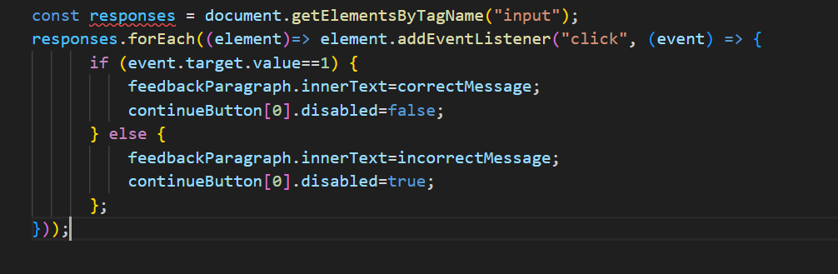
Further step: dynamically adjust the button

Slide 43
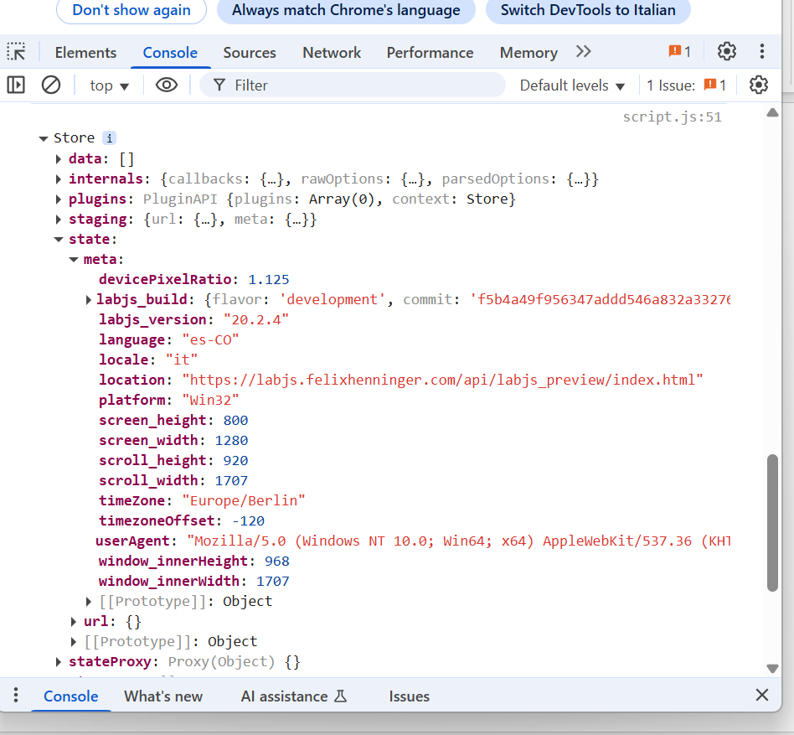
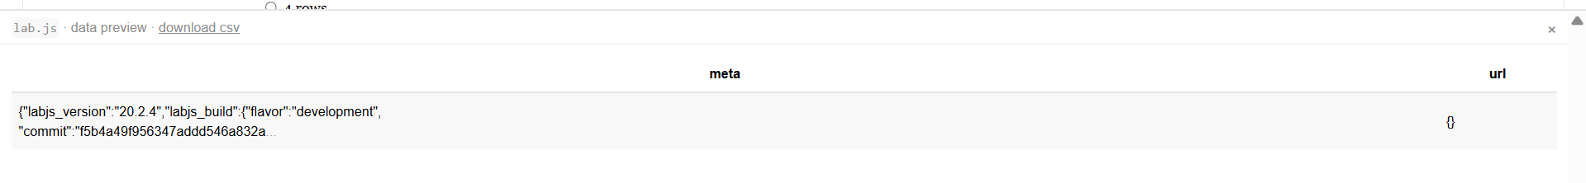
Further step: adding the attempts
let ds=this.options.datastore;
console.log(ds);

Slide 44
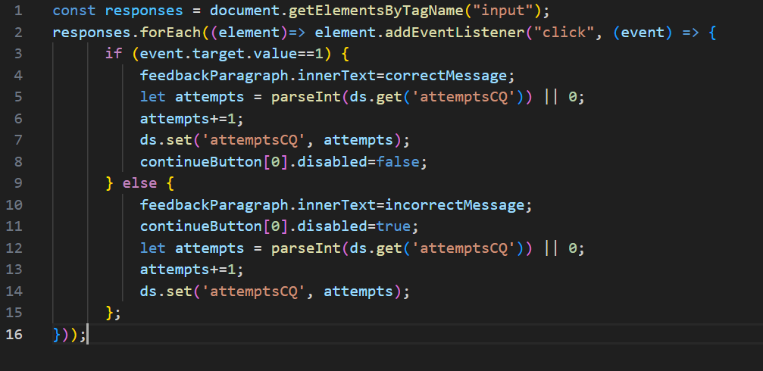
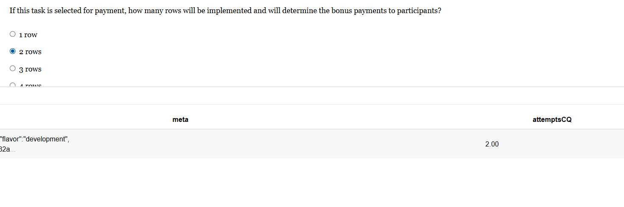
Showing the data collection

Slide 45





The data structure
While the code is executed, you have the state
Notice the «sender»: the database is «long», with each page playing the role of a «t» [as a «panel»]

Slide 46
Lecture 5

Slide 47

Completing the task for MPL
We can build a Table within a div environment
We need to introduce CSS elements
We use radiobuttons for each row of the MPL

Slide 48

Introducing a sequence
We can group together the MPL task

Slide 49


Using the sequence object
The sequence creates a group of pages
The equivalent in Qualtrics is the «group» object in SurveyFlow

Slide 50
The Loop
The other key sequence tool is the loop.
We will see how it works in the context of the treatment assignment

Slide 51

The Loop
We can manipulate social identity using the art preferences task by Chen and Li
Requirements:
A Table, with two pictures and two buttons
A loop of five rounds
We need to keep track of choices so that we are able to distinguish those who select left/right most of the times

Slide 52








loop
choices

Slide 53


Slide 54
[just to have them ready]
https://www.bellasartes.gob.ar/media/uploads/coleccion/7966.jpg
https://www.3minutosdearte.com/wp-content/uploads/2018/09/Klee-Magia-de-los-peces-1925-e1633369586262.jpg
https://es.wahooart.com/Art.nsf/O/8XYQN9/$File/Paul-Klee-Landscape-with-Yellow-Birds.jpg
https://www.artmajeur.com/medias/mini/t/o/tony-rubino/artwork/15522313_klee-burggarten-1919-painting-in-high-resolution-by-paul-klee-original-from-the-kunstmuseum-basel.jpg
https://image.invaluable.com/housePhotos/ROGALLERY/49/736249/H4175-L309842541.jpg
https://www.biografiasyvidas.com/biografia/k/fotos/kandinsky_4.jpg
https://upload.wikimedia.org/wikipedia/commons/f/f0/Vassily_Kandinsky%2C_1923_-_Circles_in_a_Circle.jpg
https://cdn.pixabay.com/photo/2021/05/24/20/36/wassily-kandinsky-6280547_1280.jpg
https://www.artmajeur.com/medias/standard/a/d/administrator/blog/6448f069731476.45206248_wassily-kandinsky-composition-7.jpg
https://www.nacion.com/resizer/I265CujoyKVOSEa7IStTSuNqm5s=/1440x0/filters:format(png):quality(70)/cloudfront-us-east-1.images.arcpublishing.com/gruponacion/CW7JQBRSA5HVVETEJVN3HVRIC4.png

Slide 55




We add tags to dynamically adjust the text

Slide 56
Lecture 6

Slide 57

Single switch
We have this MDG which is an MPL
Especially for online exp, you can end up with multiple switch because of tiredom, lack of attentions etc
We can force single switch, especially if we measure multiple things (see Econographics)

Slide 58

Single switch
Every time a left is selected, left is selected above and right below.
Every time right is selected, right is selected below and left is selected above
It should works at the extremes.

Slide 59
Action plan
Add a class to make sure you select all the radiobuttons (and make them as you like)
Select all them twice:
One loop will add the event listener;
One loop in forward direction will select on the right
One loop in backward direction will select on the left
We need to figure out the complicate cases

Slide 60
One final thing: data
We would like avoid having tons of variables for each row. Instead, one single variable with the switching point
When the decision is taken and the button is pressed, we record the final choice

Slide 61

Asyncronous matching
Assume that our last task is trust a la C&D
We have collected our trustees decisions
Perhaps we even have the promises

Slide 62

Asyncronous matching
We need to manage the matching
We need dynamic text for the promise
Ideally, we should match just once

Slide 63

Asyncronous matching
We need matrices of choices, ids, promises
We need a random mechanism
We need to keep track of used indices

Slide 64

Asyncronous matching
What is the problem?
The randomization

Slide 65

Asyncronous matching
One solution. But not really
We need to manage this from the server…
This is a general problem, I want to talk about that in the end

Slide 66
Asyncronous matching: general considerations
In real time interaction, you will have a web socket (or similar protocol)
With other communication protocols (such as HTTP) you need to be able to determine exactly the queuing position and be able to manage that in the system (at the moment in which the subject enters the program, i.e. this is the problem with Qualtrics)
My suggestion is to manage this via OpenLab (things are easier if you know how to manage a server in AWS)

Slide 67
Lecture 7

Slide 68

Let’s collect data locally

Slide 69

The structure of the data

Slide 70

The structure of the data
The data come in long form, as a panel
The «row» indicator is the «sender», the webpage who sent the data
This automatically collects a number of important information on time
Whether you like the panel structure or not depends on you research question, but you can work to collapse the info (more on this later)

Slide 71

Steps for integration
You can extract the program to be deployed online
You need to provide an url (where you host the study)
You need to collect the data (you need a database)

Slide 72

Examples: Qualtrics
Open a free account on Netlify.com and drag and drop your study
You will get an url for your study (change the name, it’s usually funny, nerdy, and with a lot of experimenter demand)

Slide 73
In Qualtrics
Create a text question, and control the study as an iframe object
Create an embedded data field to collect the data (Qualtrics is then responsible to collect the data and returns them in .json)
Notice: you may also want to develop the tough part in lab.js and then implement the JS code in Qualtrics

Slide 74

In Qualtrics
Check also the visualization. Maybe it’s necessary to adapt style

Slide 75

OpenLab
There are several options which allows a direct integration with lab.js
The most user friendly is OpenLab

Slide 76
Open Lab
Let me show simply how it works
You set up the task. This is fully integrated with lab.js, so just upload the json file
You setup a study (number of studies depends on the account)

Slide 77

Randomization setup

Slide 78

Randomization setup

Slide 79

Change in the code
Careful, the sequence should be built transferring the components from the last to the first
We need to properly update the code to detect the «treatment» and «index» from the parameters

Slide 80

Integration with Prolific
You can obviously collect data in the lab or recruit people
There are increasing options online, the most famous is Prolific
Prolific provides the sample with the required features (the service is top for the US)
To pay participants you need to capture the code

Slide 81

Integration with Prolific
We can query the code for Payment and record it in the database
Let me show you how to setup a study in Prolific
You can also use Prolific to pay your lab participants (BYOP)

Slide 82
Lecture 8

Slide 83
Wide v. long
The conventional database is wide;
For many analyses, it make sense. How do we manage the dataset in wide format?

Slide 84
Wide v. long
The conventional database is wide;
For many analyses, it make sense. How do we manage the dataset in wide format?
One way is to compact the dataset in the last «sender». In this way, we are going to have all the information in one row
How would you do it?

Slide 85
Preparing a wide
Think at the structure of the data:
There is a sender, where the value is recorded in a proper column
We want to take that value and recording it again in the same column
The key is working on the dataset

Slide 86

Preparing a wide
We see a portion of the database

Slide 87
Preparing a wide
We obviously need to manage the dataset, so we need
let ds = this.options.datastore
We need to recover the necessary data and use the set method to store them

Slide 88
Preparing a wide
The best way to do it is by using the .extract() method
We have to provide two inputs
The name of the column (the variable)
The sender
Careful, extract returns an array, let’s see an example

Slide 89

Preparing a wide
This is how it looks into the dataset
So we need to extract the proper component. In most cases, it’s gonna be zero
We also need to fix the format

Slide 90
Preparing a wide
The array format is also very important for us, to manage multiple submissions in a loop, example with ArtPreferences
In this case, the code becomes
let artPreferences = ds.extract('artPreferences', 'kleeKandinsky');
ds.set('artPreferences', artPreferences[4]);

Slide 91
Preparing a wide
If you do not care about response time, you can also bring to the last page the data the multiple response, effectively transforming all the long components into wide
It may be cumbersome but it allows you to have all the variables compacted in one line. This is particularly useful with Stata
Stata works very well with panel in wide form that you can reshape
Or panel in long form where you fill in the blanks using the line where the value has been collected
by codeid (namevar), sort: replace namevar=namevar[1] /// [_n] if script

Slide 92

Preparing a wide
Recover the order
We use the time commit

Slide 93
Lecture 9

Slide 94

Rubin Causal Model
Now, notice this: $Y_{i}^{1}−Y_{i}^{0}$ is a causal parameter: it’s defined as the contribution of the status to the behavior keeping everything else equal. However, we cannot measure that
We can try with ${E[Y}_{i}^{1}−Y_{i}^{0}]$. This is properly defined, it is the average treatment effect. The average contribution of the change of status on the outcome
Notice that this is not based on the actual distributional property of the outcome, nor it has do to on how it measured

Slide 95

Rubin Causal Model
One way to approach a research question is by thinking at the behavior we want to explore, call $Y$ the outcome (on which you want to measure the effect)
We are usually interested in some change of status, which in an experiment we control as a treatment, in our case ingroup-outgroup (call $D∈\{0,1\}$ the causal variable)
We can define the alternative potential outcome as $Y^{1}, Y^{0}$. Notice that the definition is entirely theoretical. The two APO are defined ceteris paribus

Slide 96

Rubin Causal Model
But we can define other causal parameters, like ${E[Y}_{i}^{1}−Y_{i}^{0}\left|D=1\right]$, ${E[Y}_{i}^{1}−Y_{i}^{0}\left|D=0\right], {E[Y}_{i}^{1}−Y_{i}^{0}\left|Y_{i}−C_{i}≥0\right]$
The parameter of interest is defined before even searching for the data but it represents the key connection to theory, to the literature, to the policy debate etc
Please be careful on this especially if you are dealing with observational data
Write the parameter of interest within the context of a model (it may not involve any formula)
P1: Define the parameter of interest

Slide 97

Rubin Causal Model & Measurement
For a generic i, we observe either $Y_{i}^{1}$or $Y_{i}^{0}$, but never the two. So we can write compactly
$$Y_{i}=D_{i}Y_{i}^{1}+\left(1−D_{i}\right)Y_{i}^{0}=Y_{i}^{0}+D_{i}(Y_{i}^{1}−Y_{i}^{0})$$
Sometimes this is called «switching regression». It helps us make the thought experiment about the change of status
Notice the linear formulation, which is entirely independent from assumptions about measurement, it is only a consequence of the APO definition.

Slide 98



Rubin Causal Model & Measurement
The problem with the conventional observational study is the following, you have a sample of people with $D_{i}=1$ and a sample with $D_{i}=0$ (think at RQ: does having a gun cause criminal behavior?)
$$E\left[Y_{i} | D_{i}=1\right]−E\left[Y_{i} | D_{i}=0\right]=$$
$$=E\left[Y_{i}^{1} | D_{i}=1\right]−E\left[Y_{i}^{0} | D_{i}=0\right]=$$
$$=E\left[Y_{i}^{1} | D_{i}=1\right]−E\left[Y_{i}^{0} | D_{i}=1\right]+E\left[Y_{i}^{0} | D_{i}=1\right]−E\left[Y_{i}^{0} | D_{i}=0\right]=$$

Slide 99


Rubin Causal Model & Measurement
The problem with the conventional observational study is the following, you have a sample of people with $D_{i}=1$ and a sample with $D_{i}=0$ (think at RQ: does having a gun cause criminal behavior?)
$$E\left[Y_{i} | D_{i}=1\right]−E\left[Y_{i} | D_{i}=0\right]=$$
$$=E\left[Y_{i}^{1} | D_{i}=1\right]−E\left[Y_{i}^{0} | D_{i}=0\right]=$$
$$=E\left[Y_{i}^{1} | D_{i}=1\right]−E\left[Y_{i}^{0} | D_{i}=1\right]+E\left[Y_{i}^{0} | D_{i}=1\right]−E\left[Y_{i}^{0} | D_{i}=0\right]=$$
i=1, 2, 3, …, n_T
i=1, 2, 3, …, n_C
This is a causal parameter
This is selection bias

Slide 100

Rubin Causal Model & Measurement
Don’t think at this as something silly. A linear regression of crime on gun ownership is actually $E\left[Y_{i} | D_{i}=1\right]−E\left[Y_{i} | D_{i}=0\right]$
The problem is that we are estimating something that converges to something that is not what we want, because it includes the causal parameter (something that we want) and a source of bias
In other words, there is more than one interpretation possible from our data. Example: positive correlation -> x causes y or x is more likely when y is higher

Slide 101

Rubin Causal Model & Measurement
Estimating a causal parameter has to do with being in a situation in which the data can be interpreted in only one way.
This is equivalent to say «I can estimate correctly $E[Y^{0}|D=1]$», the counterfactual
Finding the minimal set of assumptions that allows you to estimate the counterfactual is called the problem of identification
P2: what is your identification strategy?

Slide 102
Rubin Causal Model & Measurement
Again, notice that we haven’t said anything about the structure of the data
The research design has to do with how you pretend to identify something
Selection on observables
RDD
Diff-in-Diff

Slide 103

Example: RDD

Slide 104

Identification and experiments
The reason why we prefer experiments is that we get the identification from the beginning
If $D_{i}$ is randomly assigned it is independent from potential outcomes. On average (except for sampling variability) what I observe $E\left[Y_{i}^{0} | D_{i}=0\right]$ is a valid estimator of the counterfactual $E\left[Y_{i}^{0} | D_{i}=1\right]$
But then $E\left[Y_{i}^{1} | D_{i}=1\right]−E\left[Y_{i}^{0} | D_{i}=0\right]=E\left[Y_{i}^{1} | D_{i}=1\right]−E\left[Y_{i}^{0} | D_{i}=1\right]=E\left[Y_{i}^{1}−Y_{i}^{0} | D_{i}=1\right]$ and we got it right!

Slide 105
Identification
Identification is not data driven. You can use whatever sophisticated technique you want, it does not make a correlation causal
Statistical tests can be valid for overidentification, but identification assumptions must be plausible (e.g. you assign D based on a lottery)

Slide 106
Estimation
We work on samples, with specific measurements. All these issues have to do with
They are obviously important, but never miss the hierarchical structure of the problem
P3: estimation

Slide 107

Now back to the switching regression
Assume that the treatment effect is not heterogeneous (it can be generalized)
$$Y_{i}=Y_{i}^{0}+D_{i}\left(Y_{i}^{1}−Y_{i}^{0}\right)=E\left[Y_{i}^{0}\right]+βD_{i}+Y_{i}−E\left[Y_{i}^{0}\right]=α+βD_{i}+ε_{i}$$
What is a regression of Y on D giving me?
The average difference in outcome between all those with D=1 and all those with D=0, now there are two scenarios

Slide 108




Scenario 1: D is not randomly assigned
$${E[Y}_{i}\left|D=1\right]=α+β+{E[ε}_{i}\left|D=1\right]$$
$${E[Y}_{i}|D=0]=α+{E[ε}_{i}|D=0]$$
$β^{ols}−>{E[Y}_{i}\left|D=1\right]−{E[Y}_{i}\left|D=0\right]=$ $β+{E[ε}_{i}\left|D=1\right]−{E[ε}_{i}\left|D=0\right]$
Selection bias

Slide 109

Scenario 2: D is randomly assigned
$${E[Y}_{i}\left|D=1\right]=α+β+{E[ε}_{i}\left|D=1\right]$$
$${E[Y}_{i}|D=0]=α+{E[ε}_{i}|D=0]$$
$β^{ols}−>{E[Y}_{i}\left|D=1\right]−{E[Y}_{i}\left|D=0\right]=$ $β+{E[ε}_{i}\left|D=1\right]−{E[ε}_{i}\left|D=0\right]=β$

Slide 110
The pros of OLS
Maybe Y is 0-1, maybe is censored, maybe is a discretized measure
All these things are important, but a linear regression if identified will give me something that is easily interpreted and that maps directly into how we defined our causal parameter
This is not against probit, logit, etc.. It refers to the fact that if your ultimate interest is on causal parameter, then the interpretation of the parameter becomes first order while the fact that your projection exceeds 0 or 1 is second order

Slide 111
Lecture 10

Slide 112

OLS
Remember the reasoning: we defined the switching regression, which has a transparent theoretical interpretation
$$Y_{i}=α+βD_{i}+ε_{i}$$
Now we would like to estimate the $β$: our parameter of interest is the causal effect of switching status
Now we need two assumptions

Slide 113

OLS
Remember the reasoning: we defined the switching regression, which has a transparent theoretical interpretation
$$Y_{i}=α+βD_{i}+ε_{i}$$
Now we would like to estimate the $β$: our parameter of interest is the causal effect of switching status
Now we need two assumptions
One is trivial: $E\left[ε\right]=0$
The other one is key $E\left[ε|D\right]=E\left[ε\right]=0$ this is called mean independence
Notice that if $E\left[ε|D\right]=0$ then $Cov\left(ε,D\right)=0$

Slide 114


What is mean independence?
 | Soft Skill=H | Soft Skill=L
Graduated | 0.16 | 0.14 | 0.30
NG | 0.37 | 0.33 | 0.70
 | 0.53 | 0.47
Technically we should write this in deviation from the mean, but it’s clearer this way
E[u]=2*0.53+1*0.47=1.53
E[u|G]=2*E[u|G]+E[u|G]=20.16/0.3+0.14/0.3=1.53

Slide 115

What is mean independence?
Source: Angrist and Pischke 2009

Slide 116

We work with samples
What do we observe? We observe a sample $Y_{i}, D_{i} i=1, …, n$
Each $Y_{i}, D_{i}$ is a random vector, and is i.i.d.
The causal model is $Y_{i}=α+βD_{i}+ε_{i}$
$ε$ contains all other factors explaining $Y_{i}$
Given what we observe, we can compute means. Without loss of generality, ${n=n}_{T}+n_{C}$
$\frac{1}{n_{T}}\sum_{i=1}^{n_{T}}{Y_{i}}\overset{→}{p}E[Y_{i}|D_{i}=1]$ $\frac{1}{n_{C}}\sum_{i=1}^{n_{C}}{Y_{i}}\overset{→}{p}E[Y_{i}|D_{i}=0]$

Slide 117


$E\left[ε|X\right]$=0 and OLS
Under $E\left[ε|X\right]$=0, we have two conditions
$E\left[ε\right]=0$ $E\left[y−α−βX\right]=0$
$E\left[εX\right]=0$ $E\left[x(y−α−βX)\right]=0$
We don’t have access to the population, we have access to a sample $Y_{i}, X_{i}$ and we can use the sample counterparts to estimate the parameters
$\frac{1}{n}\sum_{i=1}^{n}{(Y_{i}−\hat{α}−\hat{β}X_{i})}=0$
$\frac{1}{n}\sum_{i=1}^{n}{X_{i}(Y_{i}−\hat{α}−\hat{β}X_{i})}=0$
$\frac{1}{n}\sum_{i=1}^{n}{Y_{i}}=\hat{α}+\hat{β}\sum_{i=1}^{n}{X_{i}}$ so $\hat{α}=\overline{Y}−\hat{β}\overline{X}$
$\frac{1}{n}\sum_{i=1}^{n}{X_{i}(Y_{i}−\overline{Y}+\hat{β}\overline{X}−\hat{β}X_{i})}=0$ so $\hat{β}=\frac{Cov(X_{i},Y_{i})}{Var(X_{i})}$

Slide 118



$E\left[ε|X\right]$=0 and OLS
$$\frac{1}{n}X^{′}\hat{e}=0$$
$$\frac{1}{n}X^{′}\left(Y−X\hat{β}\right)=0$$
$$(X^{′}Y−X^{′}X\hat{β})=0$$
$$X^{′}(Y−X\hat{β})=0$$
$$\hat{β}={\left(X^{′}X\right)}^{−1}X′Y$$
Under $E\left[ε|X\right]$=0, we have two conditions
$E\left[ε\right]=0$ $E\left[y−α−βX\right]=0$
$E\left[εX\right]=0$ $E\left[x(y−α−βX)\right]=0$
We don’t have access to the population, we have access to a sample $Y_{i}, X_{i}$ and we can use the sample counterparts to estimate the parameters
$\frac{1}{n}\sum_{i=1}^{n}{(Y_{i}−\hat{α}−\hat{β}X_{i})}=0$
$\frac{1}{n}\sum_{i=1}^{n}{X_{i}(Y_{i}−\hat{α}−\hat{β}X_{i})}=0$
$\frac{1}{n}\sum_{i=1}^{n}{Y_{i}}=\hat{α}+\hat{β}\sum_{i=1}^{n}{X_{i}}$ so $\hat{α}=\overline{Y}−\hat{β}\overline{X}$
$\frac{1}{n}\sum_{i=1}^{n}{X_{i}(Y_{i}−\overline{Y}+\hat{β}\overline{X}−\hat{β}X_{i})}=0$ so $\hat{β}=\frac{Cov(X_{i},Y_{i})}{Var(X_{i})}$

Slide 119

Alternative story
Given whatever estimator, we can compute the predicted value for each i,$\hat{y}=\hat{α}+\hat{β}X_{i}$
For each i=1, ..., n we will have a residual, a prediction error, $\hat{e_{i}}$
If we measure the goodness of our approximation via the square of the mistake, we will get $\sum_{i=1}^{n}{{\hat{e}}_{i}^{2}}$. If we want to minimize it, we find exactly the OLS solution

Slide 120
LaLonde Study
National Supported Work Demonstration (NSW): low employability subjects (AFDC: women, ex-drug addicts, ex-criminal offenders, and high school dropouts of both sexes & similar male program)
Treatment versus control:
T: 9-18 months of employment and counseling to discuss problems and provide suggestions
C: just following
Baseline, data every 9 months, up to 4 recollections ex post (some attrition)

Slide 123
How does it look «practically»
Data from the experiment
Observational data
iid | D | Y
001 | 1 | 746
002 | 0 | 657
…
00N | 1 | 889
iid | D | Y
001 | 1 | 746
002 | 0 | 976
…
00N | 1 | 889
The regression comes out significant
The coefficient is the difference in means
The result can be interpreted causally
The regression comes out significant
The coefficient is the difference in means
The result CANNOT be interpreted causally

Slide 124

Panel and FE
With panel data, the structure of the data changes.
Conventionally, the data are managed in long structure (but remember that it is your choice when you collect them). With long structure, the iid is no longer the unique identifier of the observation

Slide 125

A specific case of interest
The independent variable has a within subject variation (e.g. our treatment only comes in t=2)
We can get rid of all variables that influence the outcome, observable or not, if they do no vary within subject
$$Y_{it}=α+βx_{it}+μ_{i}+ε_{it}$$
$$Y_{it}−Y_{i∙}=β\left(x_{it}−x_{i∙}\right)+(ε_{it}−ε_{i∙})$$
As usual, if once eliminated the fixed component, we have mean independence, we can work on the sample equivalent and we get OLS on the de-meaned data

Slide 126
Lecture 11

Slide 127
Test
Install python (remember to add to Path)
I usually work on VS but you can use PyCharm (remember to use the CoPilot)
Install scipy and pandas
Because of the nature of Python (it manages objects), the most effort-intensive part is getting the data as we want

Slide 128
Basic of test
You need to have clear whether your design is within subject of between subject
If it is bewteen, you can have indipendent test
If it is within you need to control for the dependence in the data

Slide 129




Between subject design
The starting point if usually the t-test, which test two means
Notice that a test of means is the same thing that we discussed in the regression analysis, so my recommendation is that you just use a regression
The other typical tests that are used are (this is not exaustive)
Wilcoxon rank sum test
Chi-2 test or Fisher
Kolmogorov-Smirnov
Epps-Singleton

Slide 130
Within subject design
Obviously, there exists statistical tests for within subjects design
You can run a t-test, but again, not worth it (if you are comparing means, then go for regression analysis)
The most common is the Wilcoxon test (it’s very simple to run, you just compare to columns)

Slide 131
What test should I use?
The answer I would like to give you is that it is a scientific problem (nature of the data, nature of the measurement, the hypothesis)
The reality is that it depends on whom you want to convince
An economist will usually asks for a regression analysis because you can adjust for other covariates, you can restrict noise, you can think about the standard errors etc
But there are purists that only want to see non parametric test
If you are submitting to a pyschology journal then tests are due
Pre registration is also a good way to proceed

Slide 132
Lecture 12

Slide 133
Dif in Dif
Dif in dif is the most common research design among studies which make causal claims with observational studies
It can be useful in experimental research, but one needs to understand the differences

Slide 134
Card and Krueger (1994)
New Jersey raised the minimum wage from 4.25$ to 5.05$, while Pennsylvania keeps it at 4.25$
Data collection:
Fast food: (a) they answer; (b) a lot of MW workers; (c) they will comply because of the franchise; (d) homogeneous product
Data: feb 1992, nov 1992

Slide 135
Card and Krueger (1994)

Slide 136
El estudio de Card and Krueger (1994)

Slide 137




The dif in dif in one graph
23.33
Penn
21.17
21.02
20.44
NJ
february
november

Slide 138
The dif in dif in one graph
23.33
Penn
Notice that there is an initial difference (on average they are not the same, the hypothesis is not «balancing» as per random assignment)
Penn decreases employment from 23.33 to 21.17. A 2.16 reduction
NJ increases from 20.44 to 21.02, a 0.58 increase.
Here comes the identification:
If the counterfactual change in NJ is correctly estimated by the change in Penn (what would have happened without the change in minimum wage), then the causal effect of minimum wage is 0.58 – (-2.16) = 2.74
21.17
21.02
20.44
NJ
February
November

Slide 139

The dif in dif regression with OLS
$$y_{it}=α+β^{T}D_{i}+γ^{after}D_{t+1}+δ^{T,after}\left(D_{i}∗D_{t+1}\right)+ε_{it}$$
$D_{i}$ equal to 1 if will be treated, 0 otherwise (dummy for NJ)
$D_{t+1}$ equal to one if the observation is posterior to the assignment of the treatment
$D_{i}∗D_{t+1}$ the interaction

Slide 140

Questions for you
How do I need the data to be structured?
If I estimate that model by OLS, can you tell me the exact value (the exact computation) of$\hat{β^{T}}, \hat{γ^{after}}, \hat{δ^{T,after}}$?

Slide 141

The dif in dif regression with OLS
$\hat{β^{T}}$ is the diff in outcome between NJ and Penn before;
$\hat{γ^{after}}$ is the diff in outcome between before and after in Penn;
$\hat{δ^{T,after}}$ is the diff-in-diff: the change in outcome (before and after) in NJ minus the change in outcome (before and after) in Penn
$δ^{T,after}$ is our estimation of interest. It is «correlational», it can be interpreted causally only if the identification assumption is satisfied

Slide 142
What is the identification assumption?
It is the parallel trend: in absence of the treatment, the treated units would have experienced the same change as the control units;

Slide 143

The panel structure
How do I need the data to be structured?
It is a conventional long form panel

Slide 144

The panel structure
So I do not have to use OLS, I can use the control offered by Fixed Effect
Conventionally this is the Two Way Fixed Effect approach
$$y_{it}=μ_{i}+γ_{t}+βD_{it}+ε_{it}$$
I use the FE estimator to control for individual level FE (I cannot add dummies for individuals, why?)
For $t=1,…T$ periods, I use T-1 time dummies
$D_{it}$ is equal to one when the unit is treated (e.g. NJ ex post). Same story (it’s the diff in diff once you get rid of time invariant and individual level invariant shocks)

Slide 145
Now here is where the story gets separated
Observational study
Absence of other shocks is a strong assumption.
The typical study uses staggered DiD, it makes less plausible that other shocks are confound (they should happen simultaneously at most assignments)
You cannot use TWFE (the «new» DiD literature)

Slide 146
Now here is where the story gets separated
Observational study
Experimental study
Absence of other shocks is a strong assumption.
The typical study uses staggered DiD, it makes less plausible that other shocks are confound (they should happen simultaneously at most assignments)
You cannot use TWFE (the «new» DiD literature)
Randomization is the design choice
Having pre-treatment values is helpful to control for differences due to the sampling variability
Not everywhere is ideal, as usual it depends on the RQ

Slide 147

An example from one of my study
Bogliacino, Grimalda and Pipke (2025)

